Slide 1

CIST 2931, Fall 2016
i c i o u s
Cnrl/alt/Delicious
Steven Alcorn, Zachary Weaver, Tyrus Skipper, Antonio Mosquera, Rupa Shrestha
Notes:
Ty’s Slide

Slide 2
i c i o u s
Review the code and documentation
Send/Receive from Database for Note Writing
Note Writing able to save drafts and submit
Reject functionality for Reviewer
Print functionality for Admin and Reviewer
Tom’s Planner
Notes:
Ty’s Slide
If you inherited code, how do you plan to learn enough about the code you inherited to make changes to it?
Review the code and documentation from previous groups to understand their reasons for how it was coded.
What is your project plan?
Send/Receive from Database for Note Writing, Reject functionality for Reviewer, Print functionality for the Admin and Reviewer
Note Writer able to save drafts and submit notes. We may be able to work on the calendar if time permits.
What project planning tool will you use?
Tom’s Planner

Slide 3
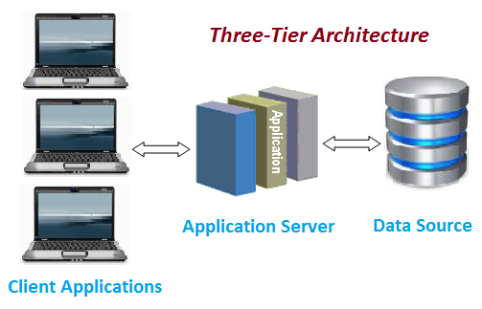
i c i o u s
3-Tier Architecture
Notes:
Antonio’s Slide
What software Architecture will be used? If you inherited one, is it the same as before or changed to something new?
We will be using the same 3-Tier Architecture that the previous group has used.

Slide 4
i c i o u s
Combination of Agile Development and Scrum
Updated versions of the software
allow them to test the new changes
Run the program and showcase new features
Notes:
Steven’s Slide
What methodology will you use?
Combination of Agile Development and Scrum
What deliverables do you plan to have at the end of each iteration?
Give the client an updated version of the software and allow them to test the new changes and make sure that everything is up to par.
How will you demonstrate your code to the class at the end of each iteration?
Run the program and showcase new features

Slide 5
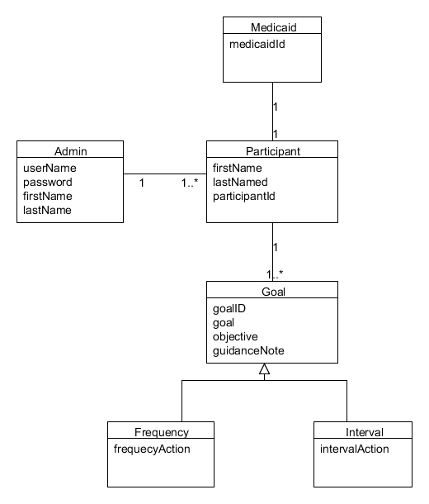
i c i o u s
UMLet
Notes:
Rupa’s Slide

Slide 6
i c i o u s
Java
MySQL Workbench
Work with the IT Department within the company
Communication
Team leader has a master copy
Notes:
Steven’s Slide
What Languages, Databases, Server software will you use?
Java, MySQL Workbench
How will you install your application to the users machine?
Work with the IT Department within the company
How will you control changes to the source code?
Maintain proper communication within the group and the team leader have a master version of the software

Slide 7
i c i o u s
We utilize use cases and displays
Results
Create test that will make sure all functions work properly and also create some tests that should not work.
Maintain a log of all test code to compare with new tests
Notes:
Zach’s Slide
How will you test your code?
We utilize use cases and displays
How will you define your tests?
Results
How will you develop your tests?
Create test that will make sure all functions work properly and also create some tests that should not work.
How will you manage repeatable tests to your code for each iteration?
Maintain a log of all test code to compare with new tests

